Slide 1
Common Widgets

Slide 2
Topics
Common flutter-cli commands
Widgets for Structure and Navigation
Widgets for Displaying Information
Widgets for Positioning Widgets
Composing Widgets
Handling User Interaction

Slide 3
Common flutter-cli Commands
flutter create my_app
flutter test
flutter run lib/main.dart
flutter pub get
flutter pub upgrade
https://docs.flutter.dev/reference/flutter-cli

Slide 4
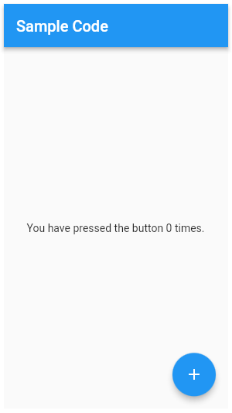
Using Scaffold Widget
Scaffold is one of the most commonly-used Material widgets in Flutter
It Implements the basic material design visual layout structure
Used for structuring and navigation purposes
It’s composed of
AppBar, BottomSheet, BottomNavigationBar, Drawer, FloatingActionButton, and SnackBar

Slide 5
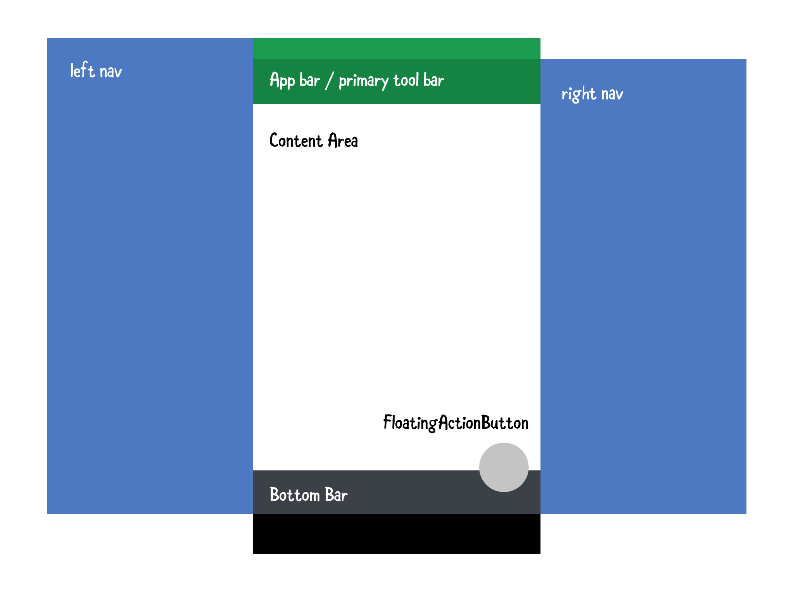
Scaffold

Slide 6
Bottom Navigation
A material widget that's displayed at the bottom of an app for selecting among a small number of views
A bottom navigation bar is usually used in conjunction with a Scaffold

Slide 7
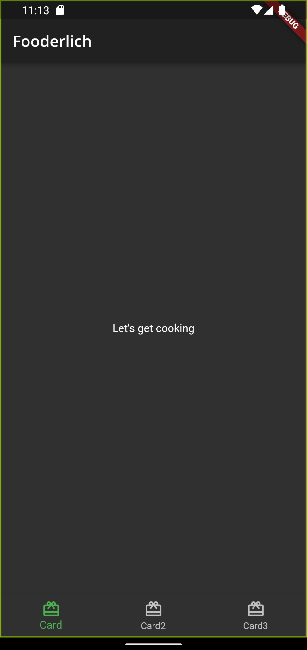
Bottom Navigation
Scaffold(
// …
bottomNavigationBar: BottomNavigationBar(
// …
currentIndex: _selectedIndex,
items: <BottomNavigationBarItem>[
const BottomNavigationBarItem(
icon: Icon(Icons.card_giftcard),
label: 'Card',
),
// …
],
),}

Slide 8
Navigating between items
How to change the content of the Scaffold body when the bottom navigation tabs are tapped
Example elements
static List<Widget> pages = <Widget>[
Container(color: Colors.red),
Container(color: Colors.blue),
Container(color: Colors.amber)
];

Slide 9
Navigating between items
We can used the currentIndex property value to select a widget from the widget array, we can then assign the selected widget to the body of the Scaffold widget
static List<Widget> pages = <Widget>[
Container(color: Colors.red),
Container(color: Colors.blue),
Container(color: Colors.amber)
];

Slide 10
Navigating between items
Scaffold(
// ...
body: pages[_selectedIndex],
bottomNavigationBar: BottomNavigationBar(
currentIndex: _selectedIndex,
onTap: _onItemTapped,
items: <BottomNavigationBarItem>[
// ...
],
),

Slide 11
Navigating between items
class _HomeState extends State<Home> {
int _selectedIndex = 0;
void _onItemTapped(int index) {
setState(() {
_selectedIndex = index;
});
}
// ...
}
The _selectedIndex property and the _onItemTapped() method

Slide 12
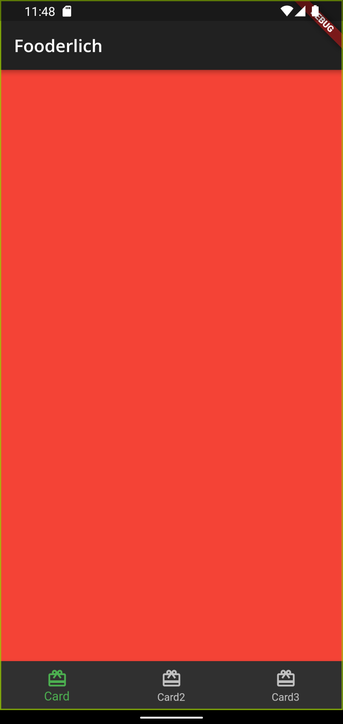
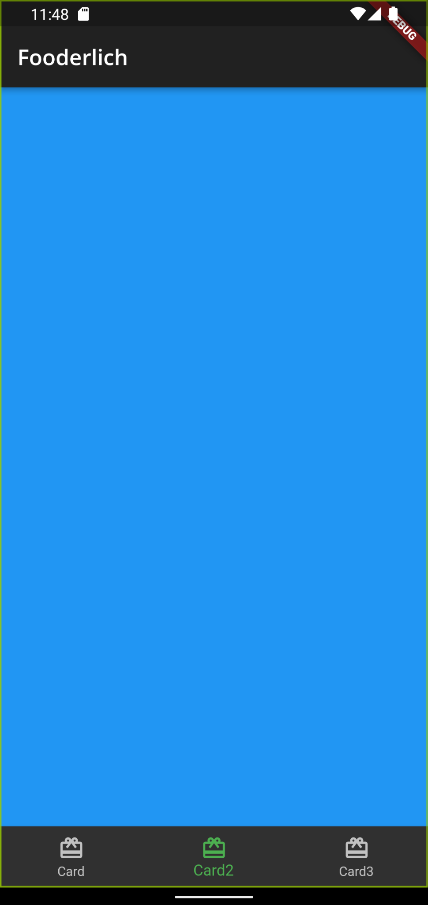
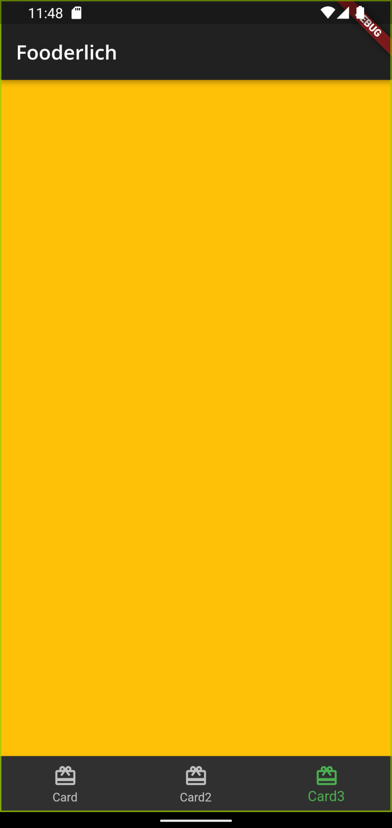

Slide 13
Display Widgets
Display widgets handle what the user sees on screen
Examples of display widgets include:
Text, Image, Button, Icon

Slide 14
Text Widget
Text(
'Hello, How are you?',
textAlign: TextAlign.center,
overflow: TextOverflow.ellipsis,
style: const TextStyle(fontWeight: FontWeight.bold),
)

Slide 15
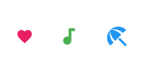
Icon Widget
Icon(
Icons.audiotrack,
color: Colors.green,
size: 30.0,
)
Icon(
Icons.favorite,
color: Colors.red,
size: 24.0,
)
Icon(
Icons.beach_access,
color: Colors.blue,
size: 36.0,
)

Slide 16
Layout/Positioning widgets
Layout widgets help with the arrangement of widgets
Examples of layout widgets include
Container, Padding, Stack, Column, SizedBox, Row, Card, GridView, ListView

Slide 17
Container Widget
The Container widget lets you create a rectangular visual element
A container can be decorated with a BoxDecoration, such as a background, a border, or a shadow
A Container can also have margins, padding, and constraints applied to its size
A Container can be transformed in three dimensional space using a matrix

Slide 18

Container Widget
Center(
child: Container(
margin: const EdgeInsets.all(10.0),
color: Colors.amber[600],
width: 48.0,
height: 48.0,
),
)

Slide 19
Row and Column Widgets
These flex widgets let you create flexible layouts in both the horizontal (Row) and vertical (Column) directions
The design of these objects is based on the web’s flexbox layout model

Slide 20
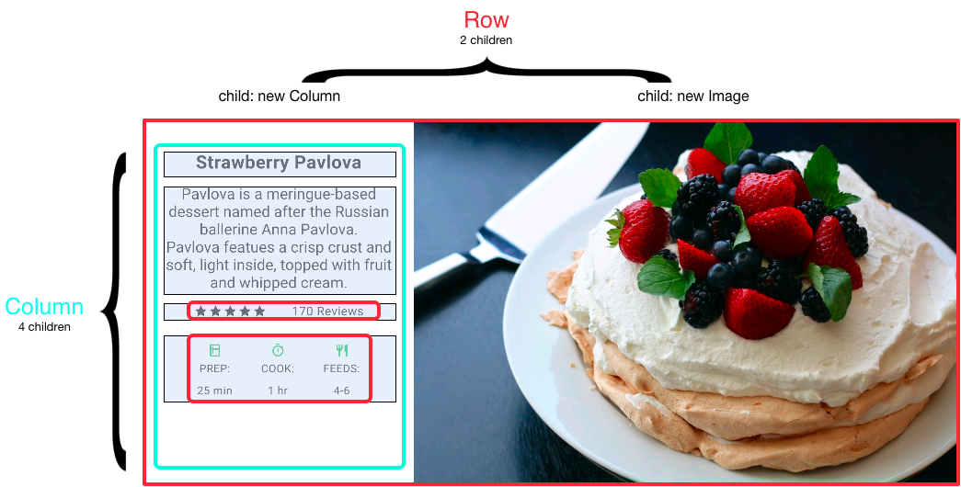
Row and Column Widgets

Slide 21
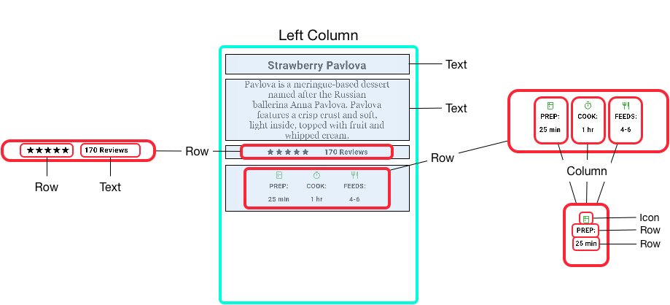
Row and Column Widgets

Slide 22
Aligning widgets
You control how a row or column aligns its children using the mainAxisAlignment and crossAxisAlignment properties

Slide 23
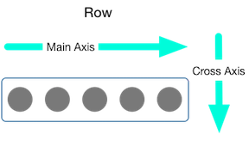
Aligning widgets
For a row, the main axis runs horizontally and the cross axis runs vertically

Slide 24
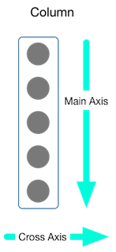
Aligning widgets
For a column, the main axis runs vertically and the cross axis runs horizontally

Slide 25

Aligning widgets
The MainAxisAlignment and CrossAxisAlignment classes offer a variety of constants for controlling alignment
Row(
mainAxisAlignment: MainAxisAlignment.spaceEvenly,
children: [
Image.asset('images/pic1.jpg'),
Image.asset('images/pic2.jpg'),
Image.asset('images/pic3.jpg'),
],
);

Slide 26

Aligning widgets
The MainAxisAlignment and CrossAxisAlignment classes offer a variety of constants for controlling alignment
Column(
mainAxisAlignment: MainAxisAlignment.spaceEvenly,
children: [
Image.asset('images/pic1.jpg'),
Image.asset('images/pic2.jpg'),
Image.asset('images/pic3.jpg'),
],
);

Slide 27
GridView Widget
Use GridView to lay widgets out as a two-dimensional list
GridView provides two prefabricated lists, or you can build your own custom grid
When a GridView detects that its contents are too long to fit the render box, it automatically scrolls

Slide 28

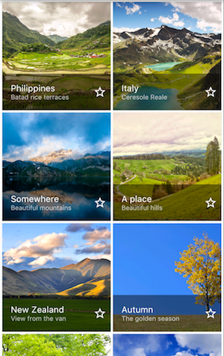
GridView Widget

Slide 29
GridView Widget
Widget _buildGrid() => GridView.extent(
maxCrossAxisExtent: 150,
padding: const EdgeInsets.all(4),
mainAxisSpacing: 4,
crossAxisSpacing: 4,
children: _buildGridTileList(30));
List<Container> _buildGridTileList(int count) => List.generate(
count, (i) => Container(child: Image.asset('images/pic$i.jpg')));

Slide 30
ListView Widget
A specialized Column for organizing a list of boxes
Can be laid out horizontally or vertically
Detects when its content won’t fit and provides scrolling
Less configurable than Column, but easier to use and supports scrolling

Slide 31
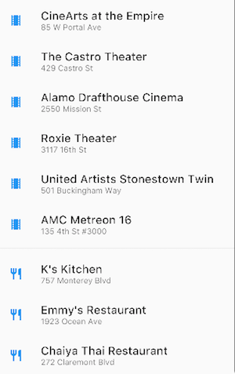
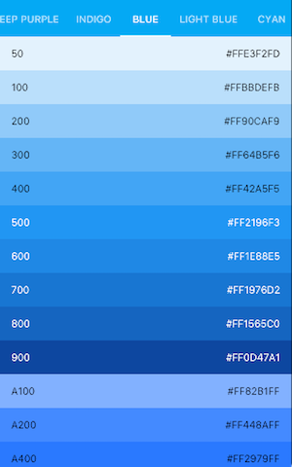
ListView Widget

Slide 32
ListView Widget
Widget _buildList() => ListView(
children: [
_tile('CineArts at the Empire', '85 W Portal Ave', Icons.theaters),
_tile('The Castro Theater', '429 Castro St', Icons.theaters),
...
Divider(),
_tile('K\'s Kitchen', '757 Monterey Blvd', Icons.restaurant),
_tile('Emmy\'s Restaurant', '1923 Ocean Ave', Icons.restaurant),
],
);

Slide 33
ListView Widget
ListTile _tile(String title, String subtitle, IconData icon) => ListTile(
title: Text(title,
style: TextStyle(
fontWeight: FontWeight.w500,
fontSize: 20,
)),
subtitle: Text(subtitle),
leading: Icon(
icon,
color: Colors.blue[500],
),
);

Slide 34
Stack Widget
Use Stack to arrange widgets on top of a base widget—often an image
The widgets can completely or partially overlap the base widget
Use for widgets that overlap another widget
The first widget in the list of children is the base widget; subsequent children are overlaid on top of that base widget
A Stack’s content can’t scroll

Slide 35


Stack Widget

Slide 36
Stack Widget
Widget _buildStack() => Stack(
alignment: const Alignment(0.6, 0.6),
children: [
CircleAvatar(
backgroundImage: AssetImage('images/pic.jpg'),
radius: 100,
),
Container(
decoration: BoxDecoration(
color: Colors.black45,
),
child: Text(
'Mia B',
style: TextStyle(
fontSize: 20,
fontWeight: FontWeight.bold,
color: Colors.white,
),
),
),
],
);

Slide 37
Card Widget
Implements a Material card
Used for presenting related nuggets of information
Accepts a single child, but that child can be a Row, Column, or other widget that holds a list of children
Displayed with rounded corners and a drop shadow
A Card’s content can’t scroll

Slide 38
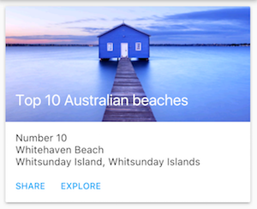
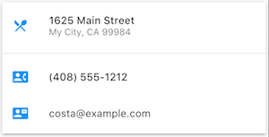
Card Widget
Often used with ListTile
By default, a Card shrinks its size to 0 by 0 pixels
You can use SizedBox to constrain the size of a card

Slide 39
Card Widget
Widget _buildCard() => SizedBox(
height: 210,
child: Card(
child: Column(
children: [
ListTile(
title: Text('1625 Main Street',
style: TextStyle(fontWeight: FontWeight.w500)),
subtitle: Text('My City, CA 99984'),
leading: Icon(
Icons.restaurant_menu,
color: Colors.blue[500],
),
),
],),

Slide 40


Composing Widgets
The following diagram is composed of 14 widgets
The following diagram highlights the invisible widgets
The widget tree for this is shown in the next slide

Slide 41
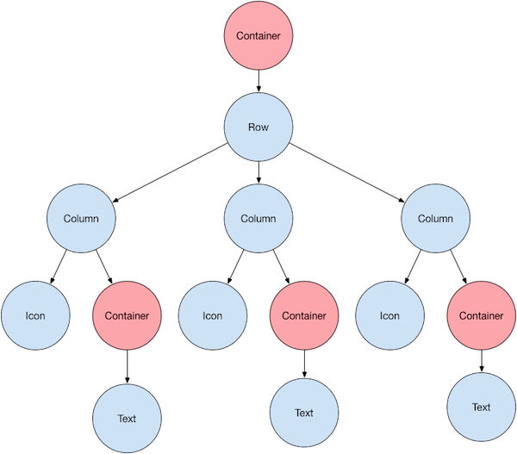
Widget Tree

Slide 42
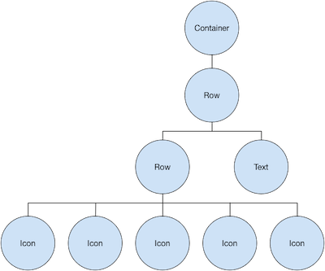
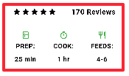
Widget Tree
The widget tree for the ratings row

Slide 43
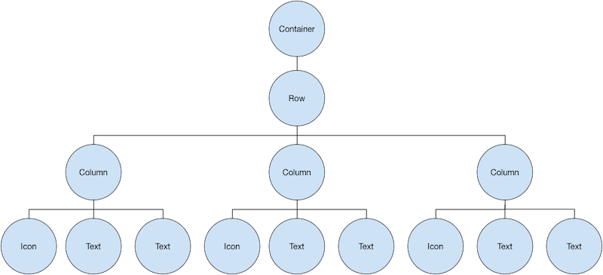
Widget Tree
The widget tree for the icons row

Slide 44
Handling User Interaction
class MyButton extends StatelessWidget {
@override
Widget build(BuildContext context) {
return GestureDetector(
onTap: () {
print('Container was tapped!');
},
child: Container(),
),
);
}
}
The GestureDetector widget doesn’t have a visual representation but instead detects gestures made by the user
You can use GestureDetector to detect a variety of input gestures, including taps, drags, and scales.
When the user taps the Container, the GestureDetector calls its onTap() callback

Slide 45
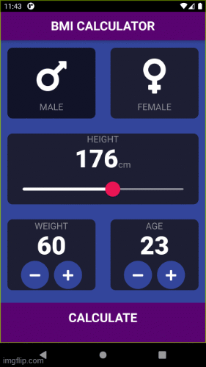
Quiz
List the possible widgets used in the app shown on the right
Show the possible widget composition in tree structure
Implement it.

